Slide 1
IMS Project
Ollie Hagger

Slide 2
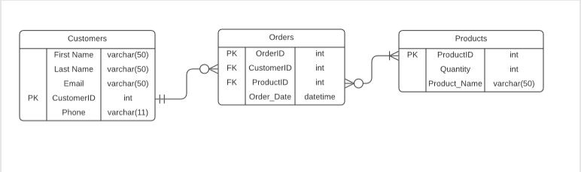
ERD

Slide 3
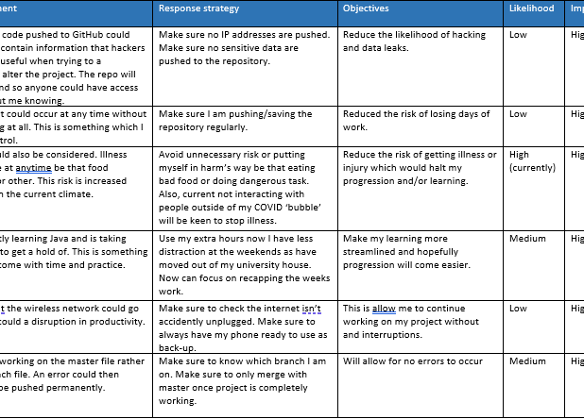
Risk Assessment

Slide 4
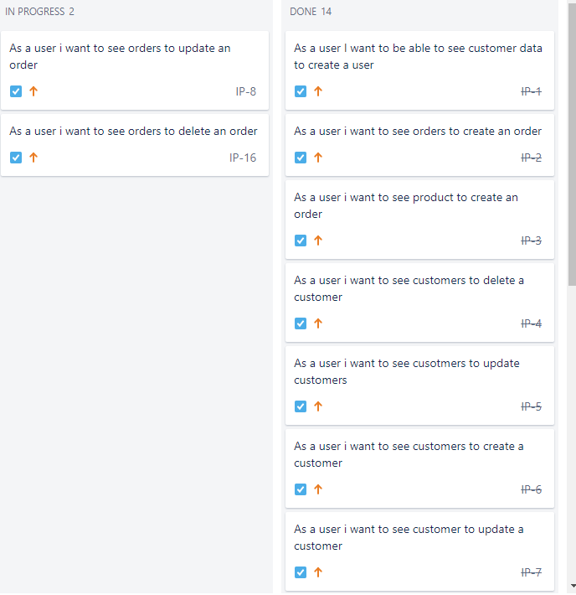
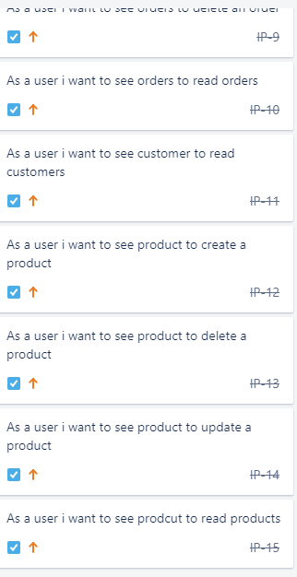
Jira Board

Slide 5
Technologies used-
Jira
GCP
Eclipse
Maven
JUnit
SonarQube
Git

Slide 6
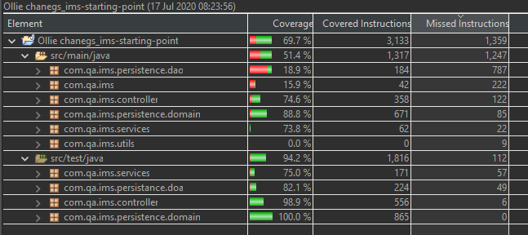
Coverage

Slide 7
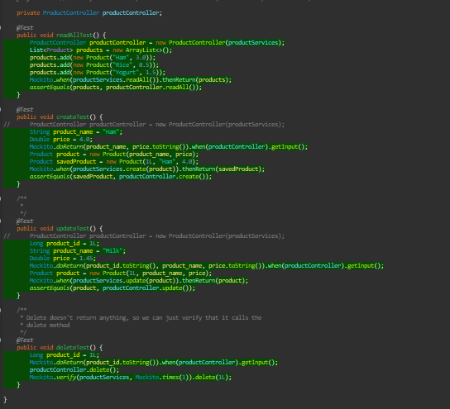
Product controller test

Slide 8
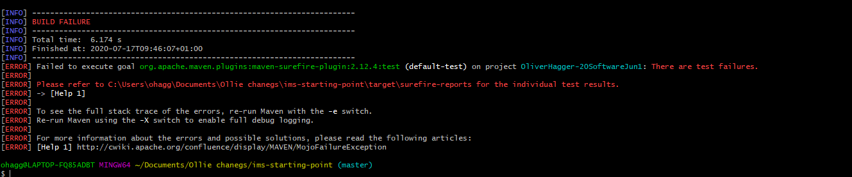
Surefire Error

Slide 9
Demo

Slide 10
Area to improve
Learn to not work on the master branch
Learn that when the project is working not to mess around with it
More frequent commits to github
Write more tests for the other part of project eg Action, Ims …
With more tests this will increase test coverage
Get knuckled down at the start and get straight into it

